Slide 1
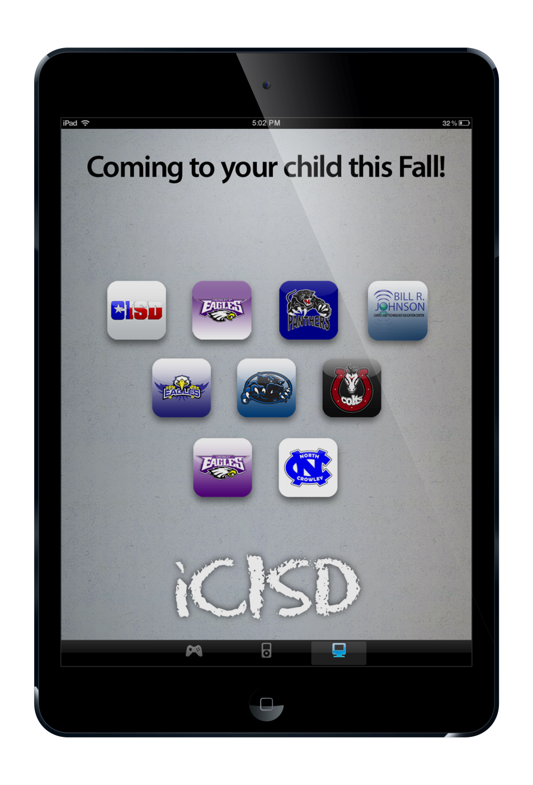

Overview of CISD
1 to 1 iPad
Initiative

Slide 2
iPad Initiative
Who? Secondary students in CISD
What? iPad mini, military grade case, charger
When? Receive October 7th-25th
Return at end of the school year
Where? For use at school and home

Slide 3
Did You Know?
The computer that guided the Apollo Space program …
Weighed 77 pounds
Had 75 bytes of memory
Cost $150,000 in 1969 dollars
($993,012 today!)

Slide 4
Did You Know?
The Apple iPad Mini …
Weighs less than 1 pound
Has 16 Gigabytes of memory
a Gigabyte has 1,073,741,824 bytes!
Costs less than $350

Slide 5
The iPad your child will use …
Is 100 times lighter …
Has 100,000 times more memory …
And costs 2,000 times less …
Than the computer that sent a man to the moon!

Slide 6
Did You Know?
Ten years ago there was no ….
Twitter --- Facebook --- YouTube
What will exist Ten Years from now?
Of the students starting school today 65% will end up with jobs that
haven’t been invented yet.

Slide 7
Did You Know?
iPads make it easier for today’s students to study on the go.
Students that study with mobile devices ….
52% study in bed before getting up.
55% study while waiting in line
74% study while traveling
This means that student are no longer limited to the brick-and-mortar buildings to achieve an education. Learning will be a continual, daily process.

Slide 8
The Crowley ISD iPad initiative will provide a greater level of educational enrichment and enhancement to current curriculum and the entire learning experience.

Slide 9
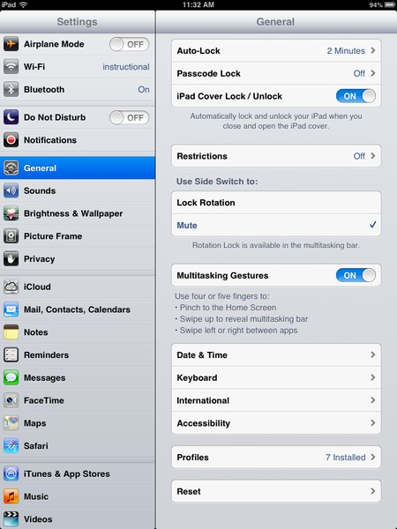
Safety
Internet filter on campus
Internet filter on device at home
Child Internet Protection Act
7 profiles
should be installed
at all times for filter.

Slide 10
Appropriate Use
Students will be able to:
Download and use digital textbooks
for some classes later this year
Use the iPad to research and complete work in class at teacher’s discretion
Make use of My Big Campus program to save files and communicate with teachers and classmates
Complete homework on the iPad
Download educational and school appropriate games and apps.

Slide 11
Student Responsibility
Students will be responsible for:
Bringing the iPad fully charged to class each day
Taking care and keeping up with the iPad
Use the iPad in a responsible manner in compliance with the CISD Student Code of Conduct and the
CISD iPad Parent/Student Acceptable Use Policy.

Slide 12
What happens if…
Students violate the CISD Student Code of Conduct or CISD iPad Agreement:
Student devices may be confiscated
A $15 fee must be paid for the iPad to be returned
Other consequences may be enforced by the
Campus administration according to the
Student Code of Conduct

Slide 13
Secondary students in CISD will need to pay a technology fee.
The technology fee is due
By October 15th.
These prices are comparable to other districts in the Metroplex such as Mansfield ISD and Lewisville ISD.

Slide 14
Technology Fee
The technology fee includes:
Increased Internet usage costs on campus
First time enrollment
in the district’s Mobile Device Manager
Additional expenses involved
with iPad initiative
Internet filtering service for both
school and home use.

Slide 15
Technology Fee
To apply for Free/Reduced Lunch based on financial need please visit the link on the Crowley ISD website under Child Nutrition.
Fee | Standard | Reduced Lunch Scholarship | Free Lunch Scholarship
Annual Technology Fee | $50.00 | $25.00 | $10.00

Slide 16
Insurance
We recommend GoCare Insurance for the devices.
Visit: www.gocare.com/crowley
For more information
Yearly Cost | Deductible
$32 | $50
$34 | $25

Slide 17
What happens if…
Students remove the MDM profiles:
Students will be charged $15 to reinstall the profiles
Other consequences may be enforced by the campus administration according to the Student Code of Conduct
Most importantly – the device is no longer safe or CIPA compliant.

Slide 18
What happens if…
The iPad becomes lost or stolen:
Students will then be required to purchase iPad insurance.
Fee | Standard | Reduced Lunch Scholarship | Free Lunch Scholarship
iPad Replacement | $309 | $309 | $309
Cord Replacement | $25 | $15 | $15
Screen Replacement | $25 | $15 | $15
Case Replacement | $25 | $20 | $15
Various iPad Repairs | $25 | $15 | $15

Slide 19
You can pay the technology fee online in Family Access

Slide 20
Please direct questions to
Bradley Parker Coordinator of Instructional Technology
bcparker@crowley.k12.tx.us
Stacey Dudzinski North Crowley High School
stacey.dudzinski@crowley.k12.tx.us
Chris Tims Crowley High School
chris.tims@crowley.k12.tx.us
Donna Lorenson NC9th/CH9th
donna.lorenson@crowley.k12.tx.us
Tim Grijalva HF Stevens Middle School
timothy.grijalva@crowley.k12.tx.us
Colby Howerton Crowley Middle School
colby.howerton@crowley.k12.tx.us
Michelle Bothel Summer Creek Middle School
michelle.bothel@crowley.k12.tx.us

